Slide 1
Model evaluation

Slide 2
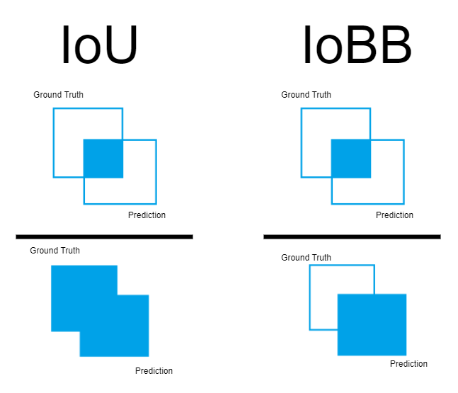
IoU and IoBB

Slide 3
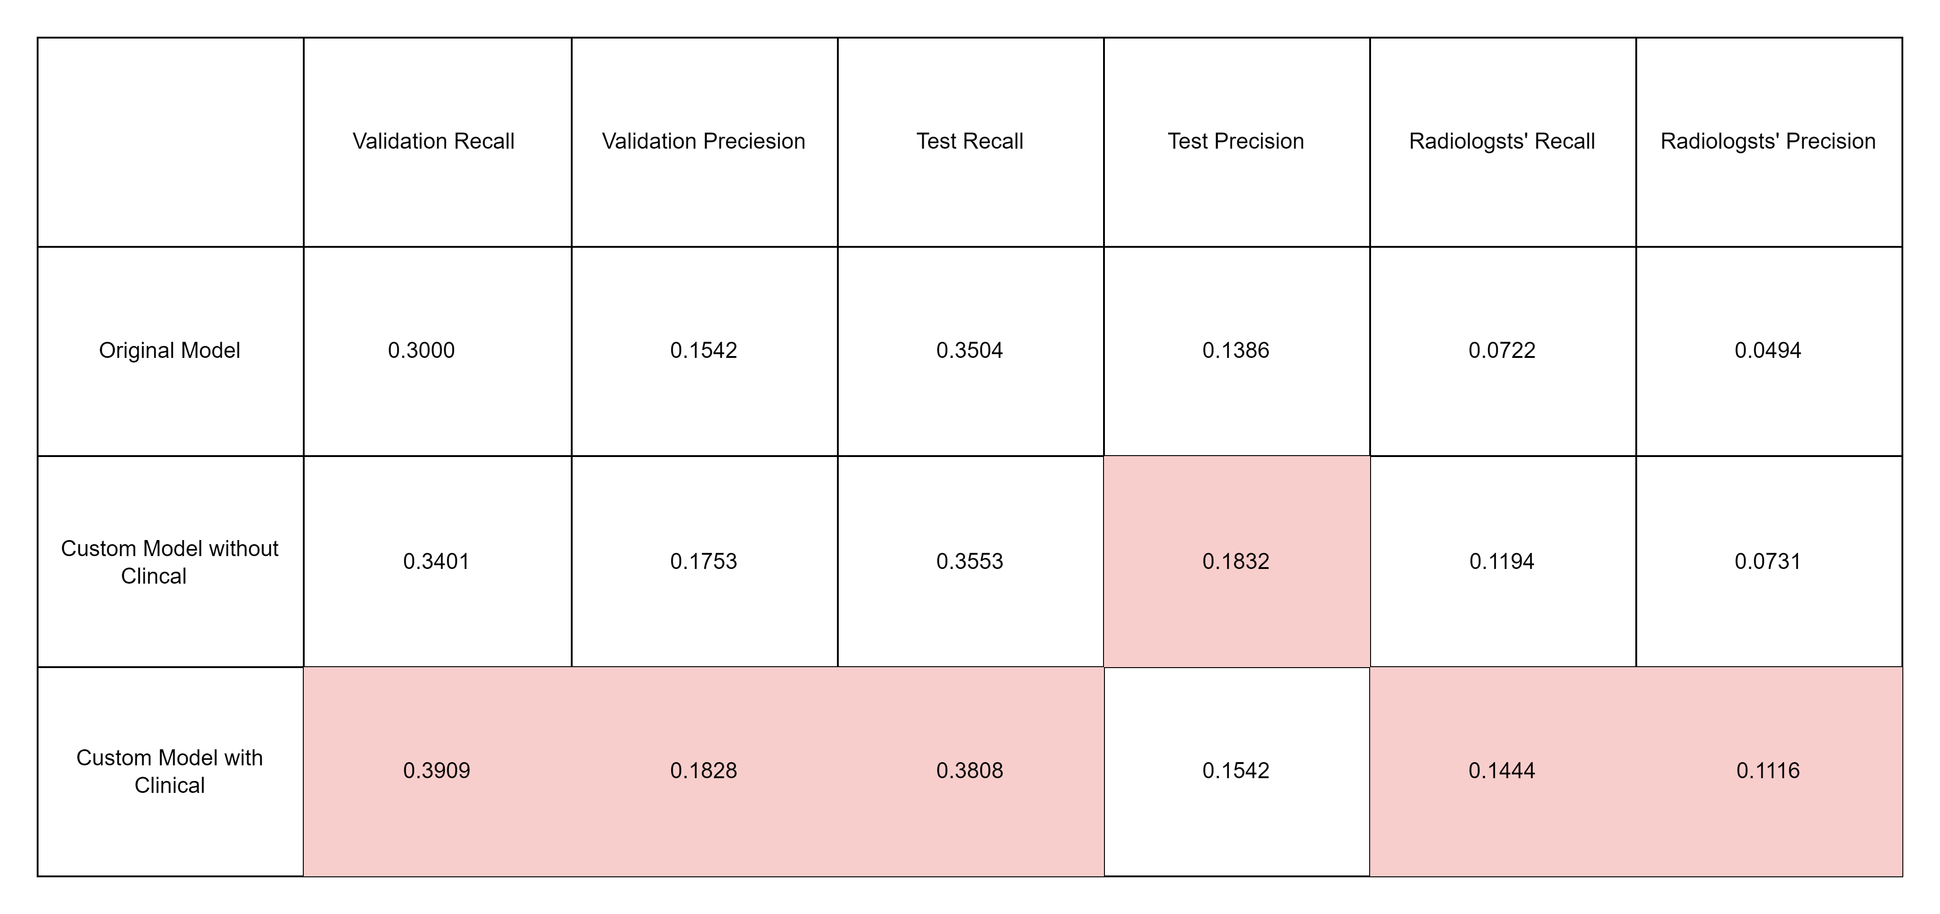
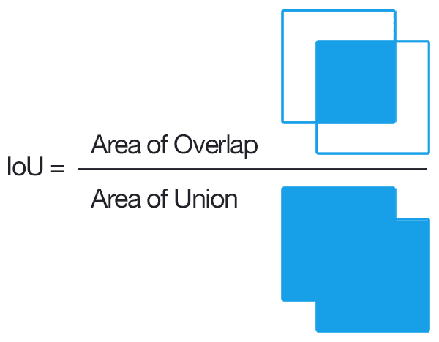
Evaluation on validation and test set. (IoU = 0.5)
The IoU threshold is 0.5 in this evaluation, which means if the prediction has more than 0.5 IoU with ground truth, it can be considered as a correct prediction.

Slide 4
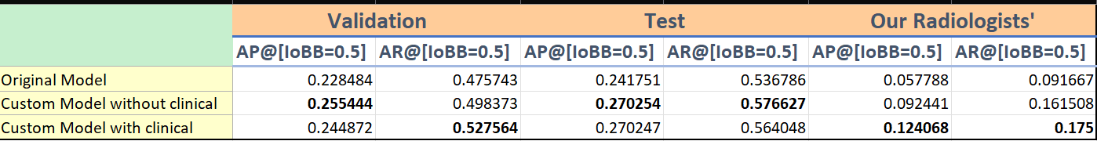
Evaluation on validation and test set. (IoBB = 0.5)

Slide 5
Evaluation on different IoU and IoBB threshold.

Slide 6
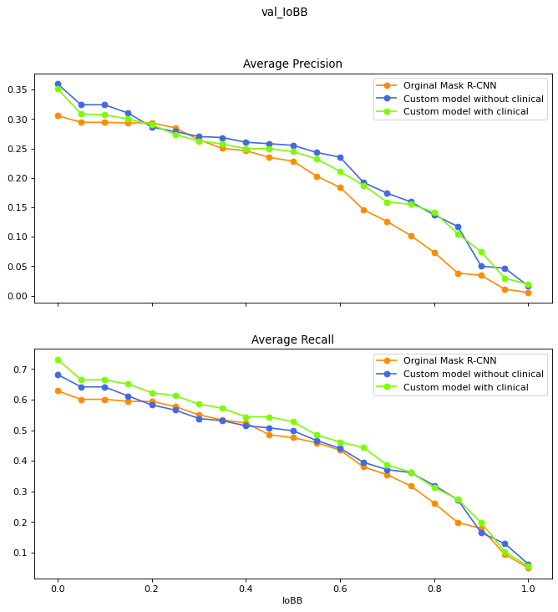
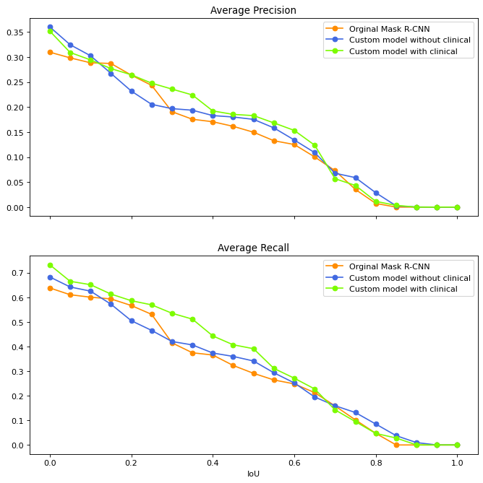
Validation set.
IoBB
IoU

Slide 7
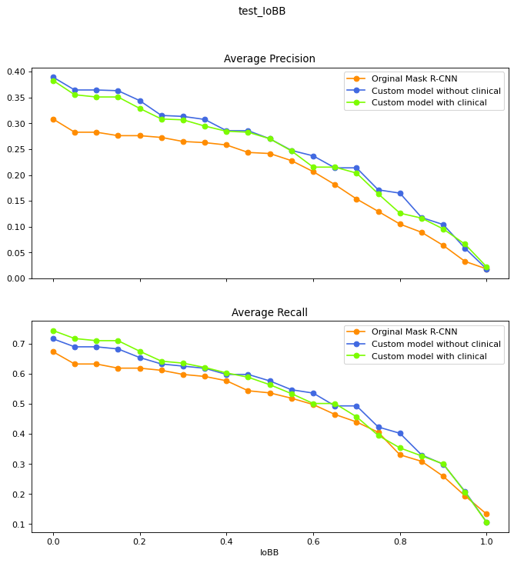
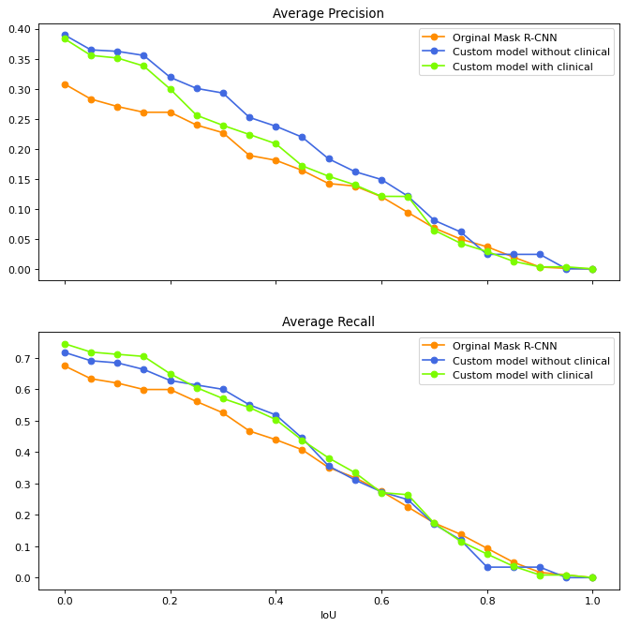
Test set
IoBB
IoU

Slide 8
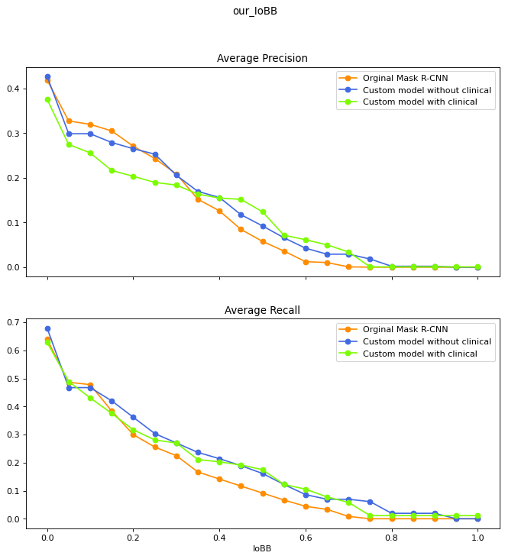
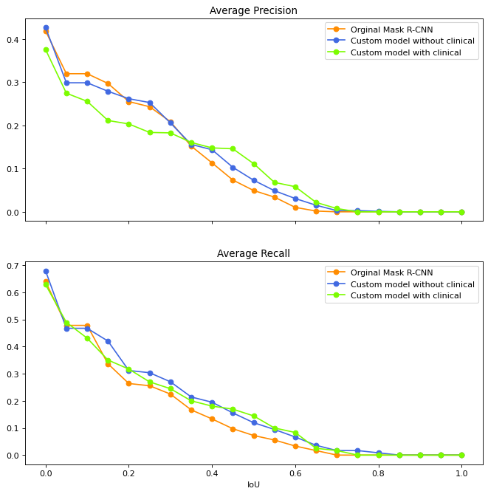
Evaluated on our radiologists’ annotations.
IoBB
IoU

Slide 9
AP & AR for Each Disease

Slide 10
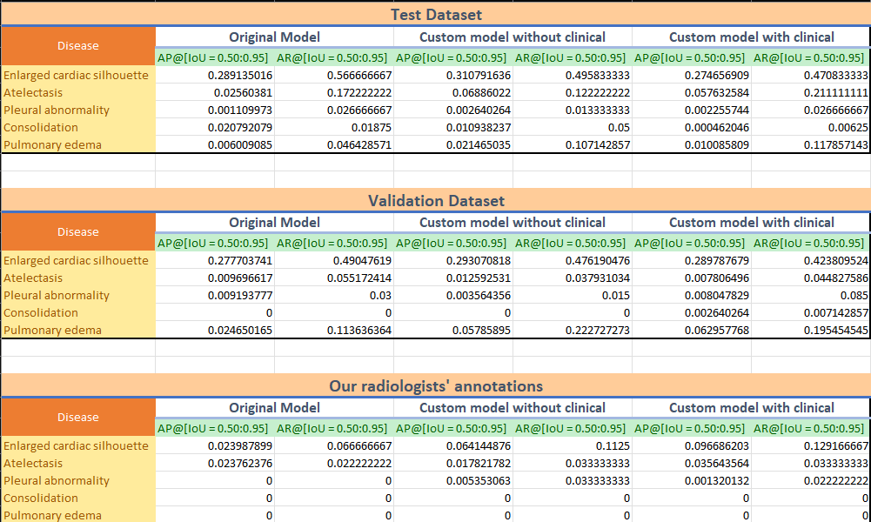
Using IoU threshold

Slide 11
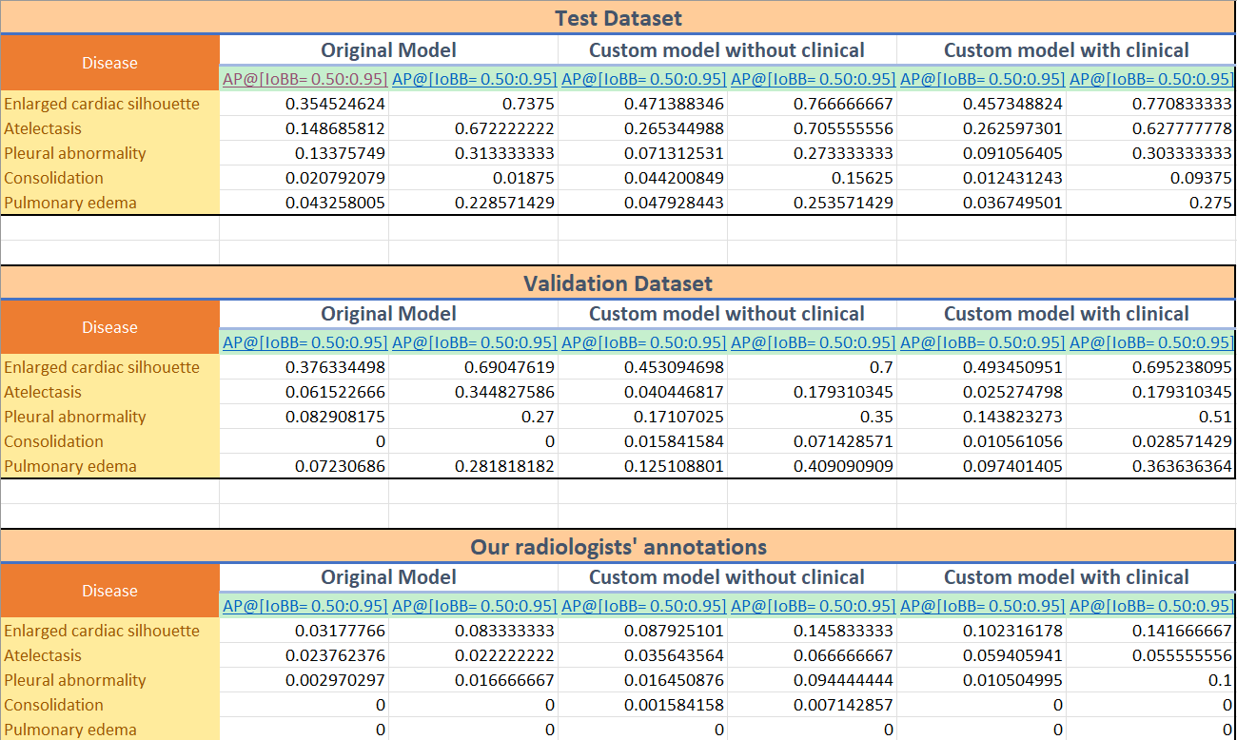
Using IoBB threshold

